Slide 1
Capstone Engagement
Assessment, Analysis, and Hardening of a Vulnerable System

Slide 2
Table of Contents
This document contains the following sections:
01
Network Topology
02
Red Team: Security Assessment
03
Blue Team: Log Analysis and Attack Characterization
Hardening: Proposed Alarms and Mitigation Strategies
04

Slide 3
Network Topology
3

Slide 4
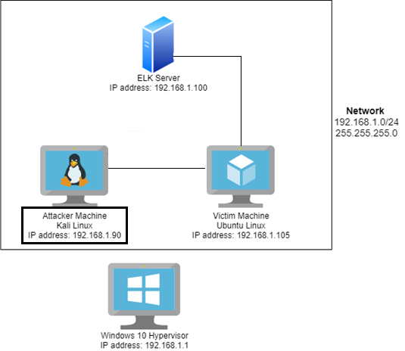
Network Topology
Network
Address Range: 192.168.1.0/24
Netmask: 255.255.255.0
Gateway: 192.168.1.1
Machines
IPv4: 192.168.1.1
OS: Windows 10
Hostname: ML-REFVM 68447
IPv4: 192.168.1.90
OS: Kali Linux
Hostname: Kali
IPv4: 192.168.1.105
OS: Ubuntu
Hostname: Capstone
IPv4: 192.168.1.100
OS: Linux
Hostname: ELK

Slide 5

Red Team
Security Assessment
5

Slide 6
Recon: Describing the Target
Nmap identified the following hosts on the network:
Hostname | IP Address | Role on Network
ML-REFVM 68447 (Windows 10) | 192.168.1.1 | Windows Hyper-V hosts the ELK, Capstone, and Kali VMs.
Kali Linux VM | 192.168.1.90 | Attacker Machine
Capstone VM | 192.168.1.105 | Victim Machine
ELK Server | 192.168.1.100 | Collects network logs between attacker machine and victim machine

Slide 7
Vulnerability Assessment
The assessment uncovered the following critical vulnerabilities in the target:
Vulnerability | Description | Impact
Open Port 80 | Open ports can allow attackers to access private information and increase the risk of a data breach. | This allowed the red team to find private directory with accessible files.
Brute Force Attack Vulnerability | The ability to guess passwords against users. | A Brute Force Vulnerability allows attackers to gain information such as login credentials or hidden content.
Accessible File | LFI (Local File Inclusion) allows access into confidential files on a site. | An LFI vulnerability allows attackers to gain access to sensitive credentials.
Unsecure web-based sharing | The web-shared folder was easily accessed with stolen credentials. | We were able to place and execute malicious files on the target machine.

Slide 8
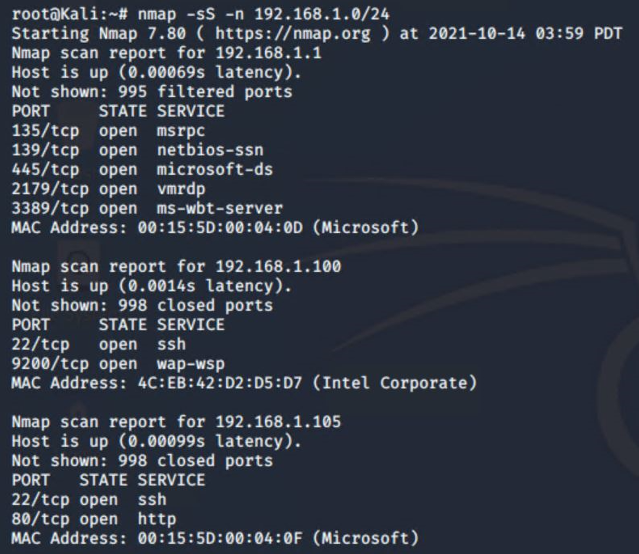
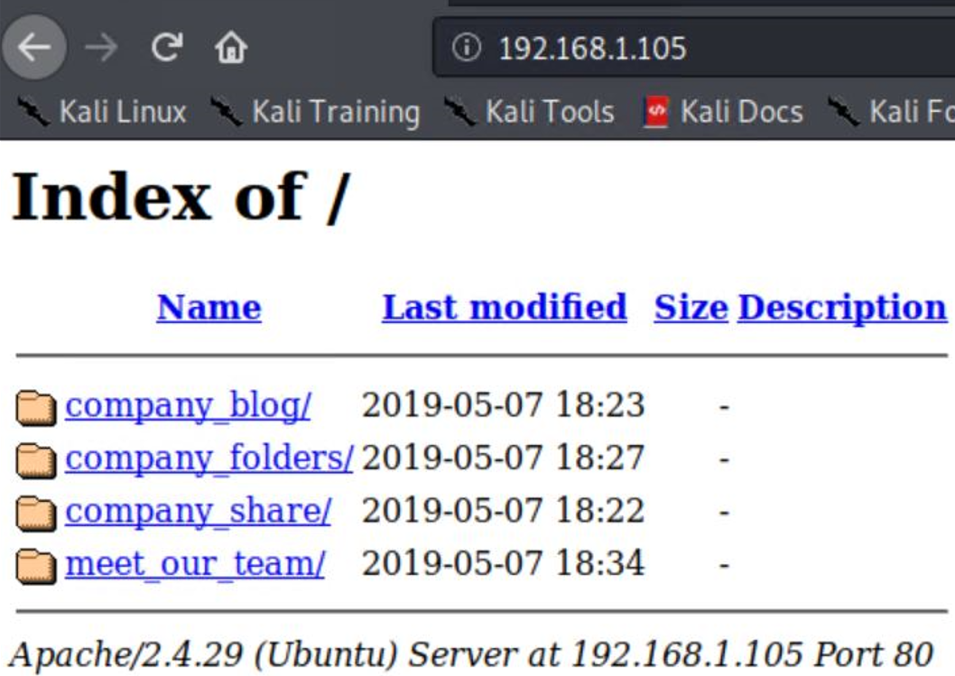
Exploitation: Port Enumeration
01
02
03
Tools & Processes
Performed nmap scan on 192.168.1.0/24, revealing IP of Target VM.
We used the “dirb” command on Kali Linux to look for hidden directories.
Navigated to Target IP website using Mozilla Firefox browser.
Achievements
Uncovered ‘secret_folder’ directory from error messages while exploring website
Attempts to access this directory subsequently revealed the username of an employee, ‘ashton’.

Slide 9
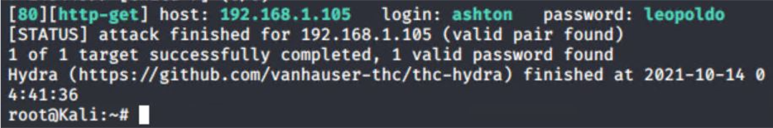
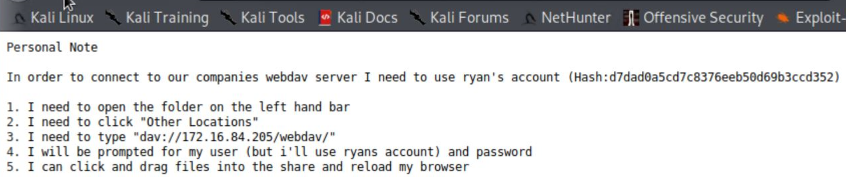
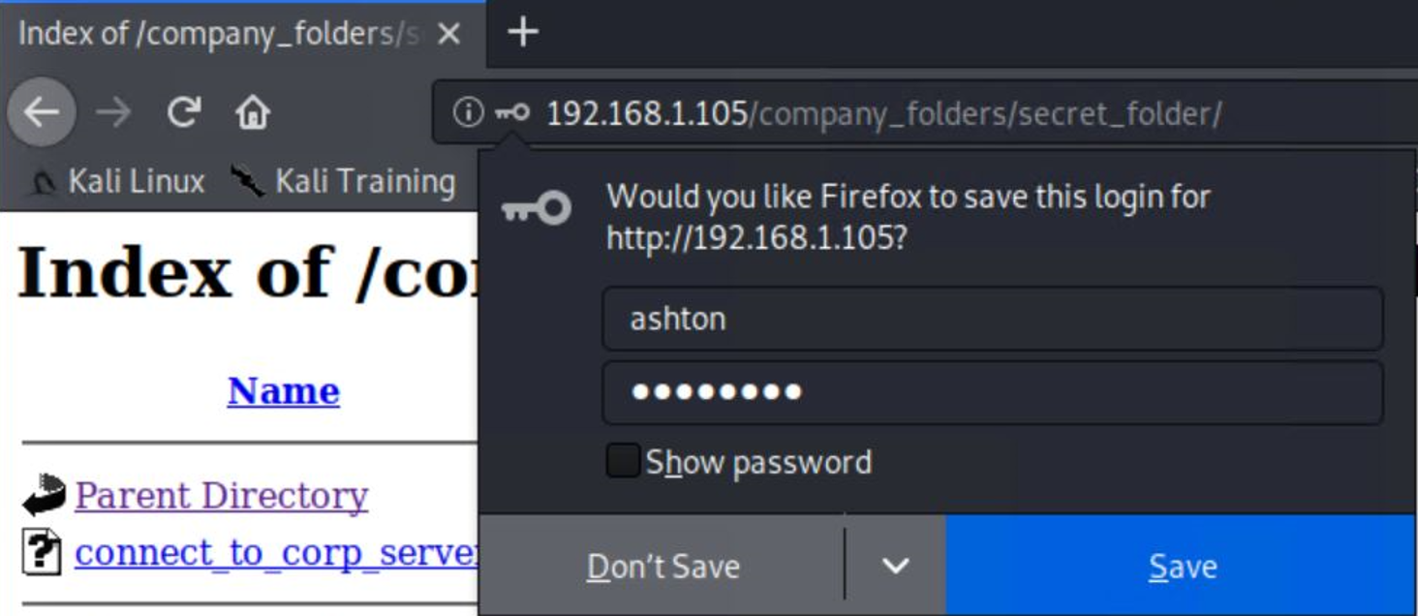
Exploitation: Brute Force Password
01
03
Tools & Processes
Discovering the secret_folder on the company share (Using the open port 80, we opened in Firefox to view directories and files). We used Hydra to brute force Ashton’s password.
02
Achievements
The exploit granted us user shell access into the victim machine so we can navigate to the secreat files.

Slide 10
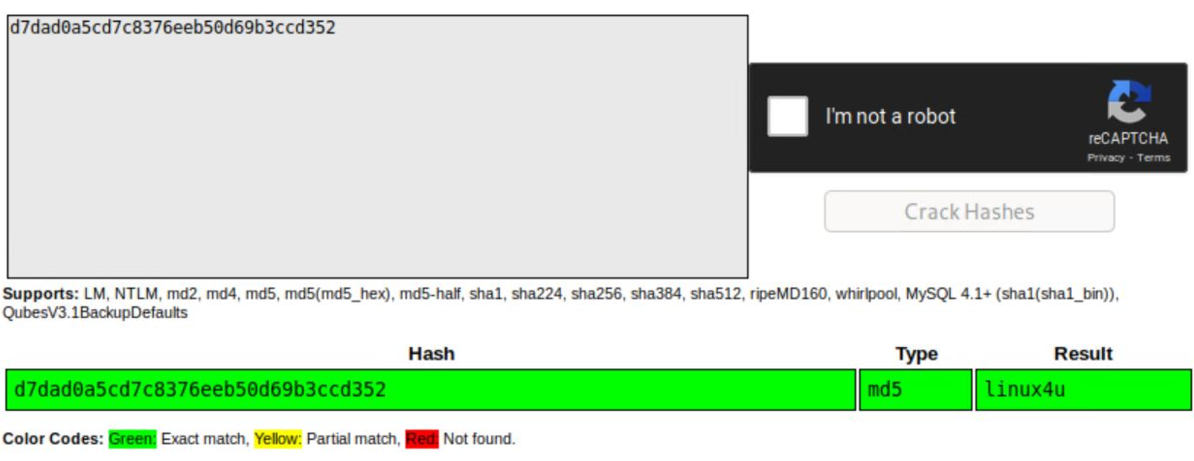
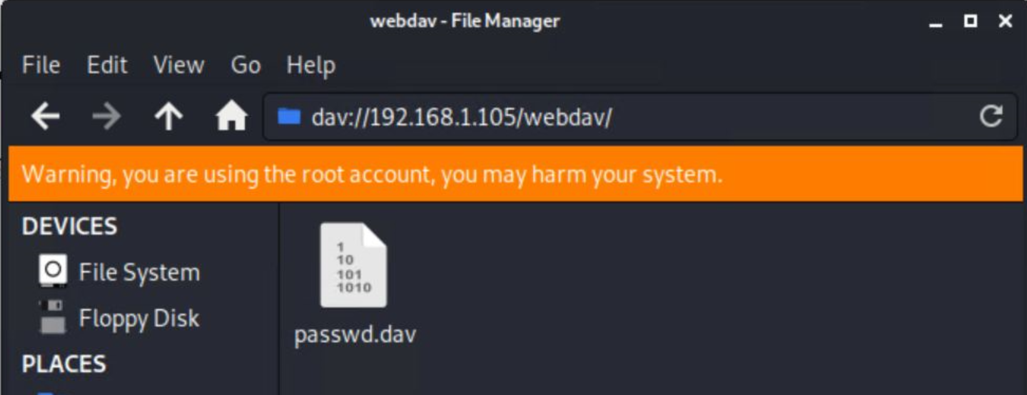
Exploitation: [Name of Second Vulnerability]
01
03
Tools & Processes
Followed Ashton’s notes in the secret folder and used CrackStation to crack Ryan’s password and connect to the webdav server using his elevated credentials
02
Achievements
Successfully cracked Ryan’s password: linux4u and connected to the webdav server

Slide 11
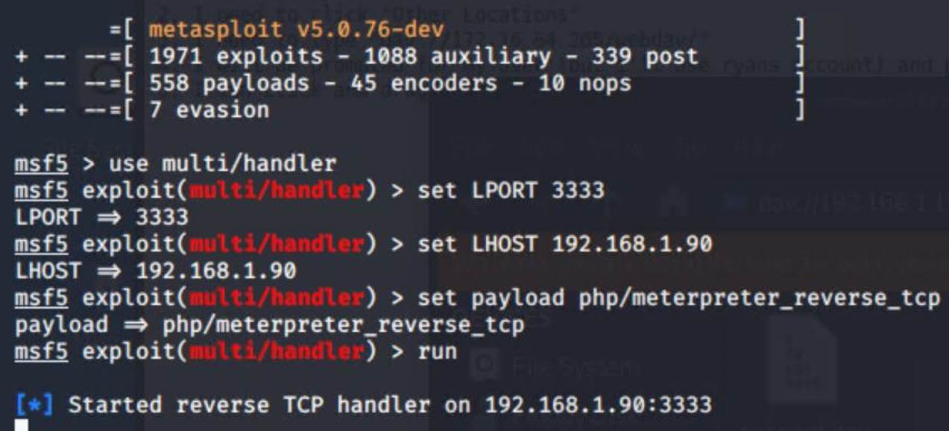
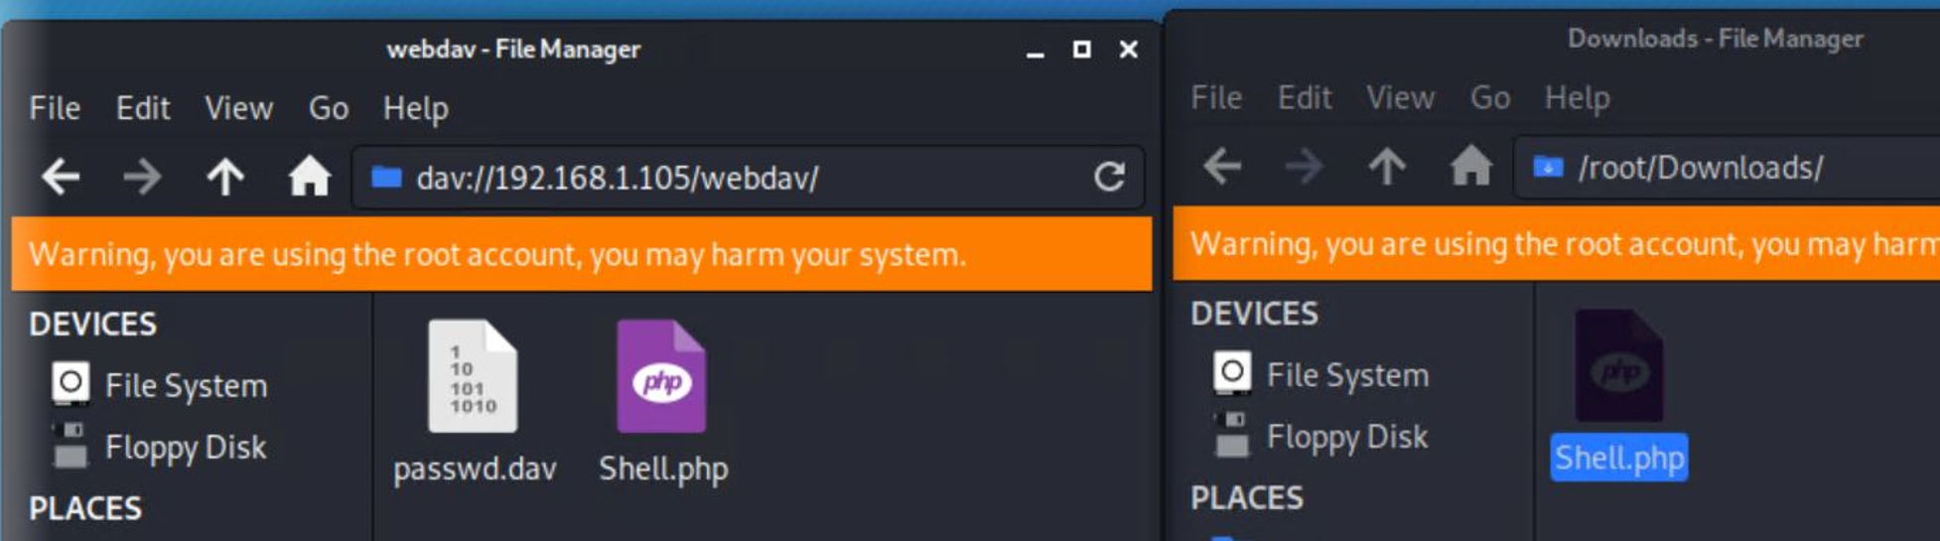
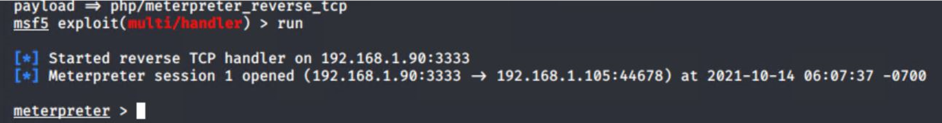
Exploitation: Reverse TCP Shell
01
02
03
Tools & Processes
Used Msfvenom to exploit the vulnerability by creating a reverse shell payload.
Achievements
The exploit allows to upload the reverse shell payload onto the server and allows to establish a remote connection with victim’s machine.

Slide 12

Blue Team
Log Analysis and Attack Characterization
12

Slide 13

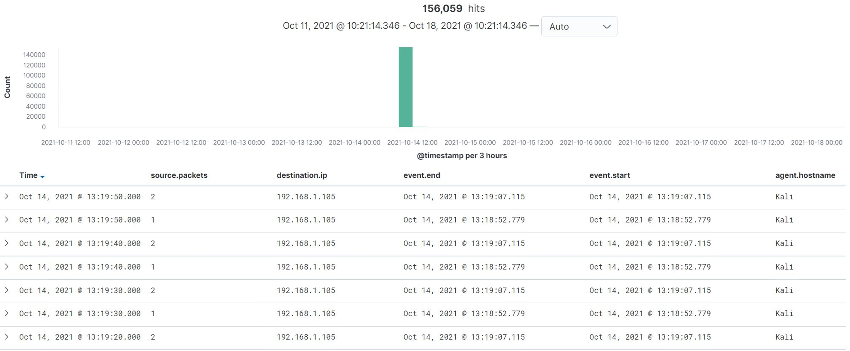
Analysis: Identifying the Port Scan
The port scan occur around 13:19 on Oct 14th 2021.
156,059 packets were sent, from 192.168.1.90
The nmap ping scan sends request to port 443.

Slide 14
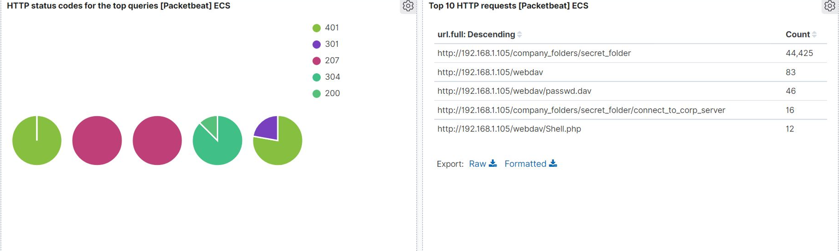
Analysis: Finding the Request for the Hidden Directory
The request occur on 14th Oct 2021 at 13:19 and total 44,425 requests were made.
The secreat_folder contained instructions on how to access the webdav server using Ryan’s account.

Slide 15
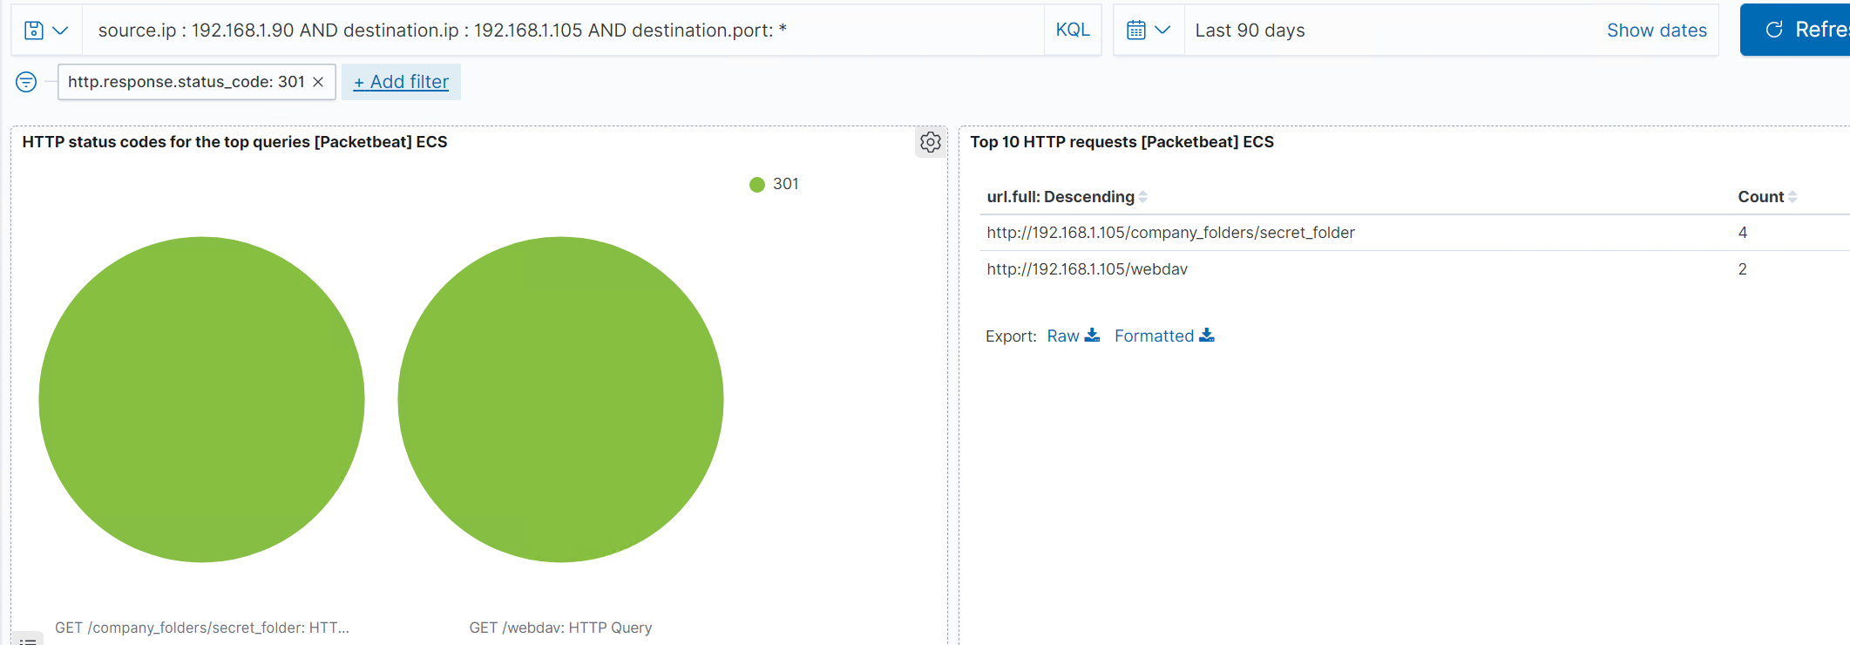
Analysis: Uncovering the Brute Force Attack
44,421requests were made in the attack.
Only 4 requests had been made before the attacker discovered the password

Slide 16
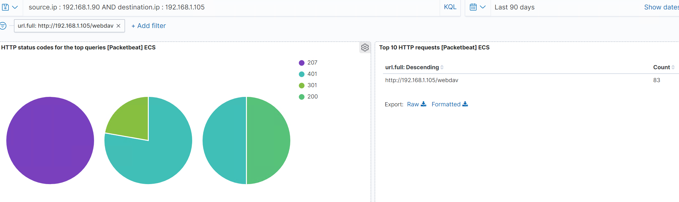
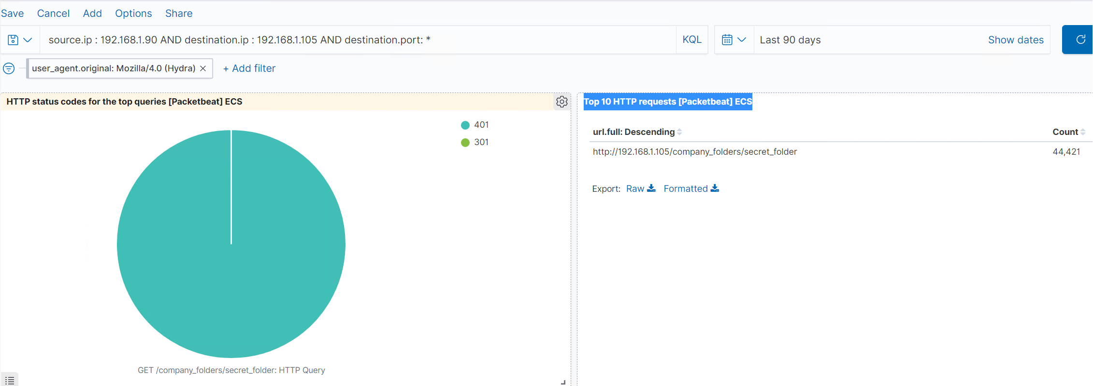
Analysis: Finding the WebDAV Connection
83 requests were made to this directory
The shell.php file was requested.

Slide 17
Blue Team
Proposed Alarms and Mitigation Strategies
17

Slide 18
Mitigation: Blocking the Port Scan
Set an alert if several packets are sent from the same source IP to several different ports.
Port scans are not inherently a threat, therefore; it is important to apply alternate countermeasures.
Close all open ports that are not needed for standard access, such as port 22.
Allow traffic that is needed to access the host(s) and deny everything else that is not needed.
This works for standard ports such as TCP 80 for HTTp and ICMP for ping requests.

Slide 19
Mitigation: Finding the Request for the Hidden Directory
Alert for brute forcing attacks if the user_agent.original value includes the names Hydra, John, or Hashcat.
Set an alert if over 10+ failed login attempts are made within 1 hour.
Lock out 10 failed login attempts from the same IP address.
Use a CAPTCHA to prevent automated login attempts.
Enable two factor authentication to not cause a DoS.

Slide 20
Mitigation: Preventing Brute Force Attacks
Set an alert if “401 Unauthorized” is returned from any server that would weed out forgotten passwords. Start with 10 attempts in one hour and refine from there.
I would start with 3 failed login attempts within 30 seconds from the same IP address.
Create a policy that locks out accounts for 30 minutes after 3 unsuccessful attempts.
Srong password policy.
Athreshold of – 401 unauthorized codes have returned from the server it can automatically drop traffic from the offending IP address for a period of one hour.

Slide 21
Mitigation: Detecting the WebDAV Connection
Create an alert for any blacklisted IPs attempting to access this directory.
All IPs outside of the set server range should be blacklisted.
The threshold for this alarm will be set at 1 and any attempts to access should trigger the alarm.
Connections to this shared folder should not be accessed from a web interface.
Connections to the shared folder should be restricted by the machine firewall rule.
Block ports 80 and 442, Blacklisting all external IPs

Slide 22
Mitigation: Identifying Reverse Shell Uploads
We can set an alert for any traffic moving over port “4444”.
We can set an alert for any “.php” ext file that is uploaded to the server.
Additionally, I would set up alarms whenever new files are uploaded that are executable.
Ensure only necessary ports are open.
A browser safe filter should be used to block any malicious executable code.
Remove the ability to upload files to the directory over the web interface would block future file uploads.

